Slide 1
How to Use this Presentation
Present with ease and wow your audience
Customize with text and photos.
Add elements from the library or upload from your drive. Apply page animations and transitions to emphasize ideas.
Use point forms and short sentences instate of long paragraphs Use the PLP pitch deck guide and follow the protocol on slides
Lastly “PLEASE DELETE THIS SLIDE WHEN YOU ARE DONE!”
02

Slide 2

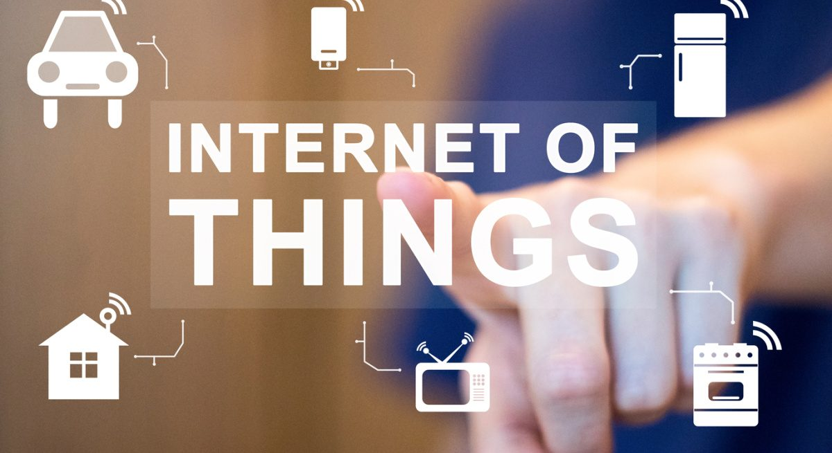
WITH TECH AND AUTOMATION LIFE IS EASY !!!
01

Slide 3

Problem Statement
"In traditional systems, physical devices such as machines, appliances, and infrastructure operate in isolation, making it difficult to monitor their status, collect data in real time, or control them remotely. This leads to inefficiencies, delayed responses, high operational costs, and poor decision-making."
10

Slide 4
Write Your Solution
By connecting devices to the internet, enabling real-time data exchange, remote monitoring, automation, and intelligent decision-making to improve efficiency, reducing costs, and enhancing user experience, IoT is used in general as a solution, with embedded systems performing specific tasks, and automating tasks.
06

Slide 5
Product
“Embedded systems as my services, are there to automate traditional systems with manual operations. With the use of the micro-controller, embedded systems are capable of solving many problems/challenges faced when using traditional systems.”
04

Slide 6
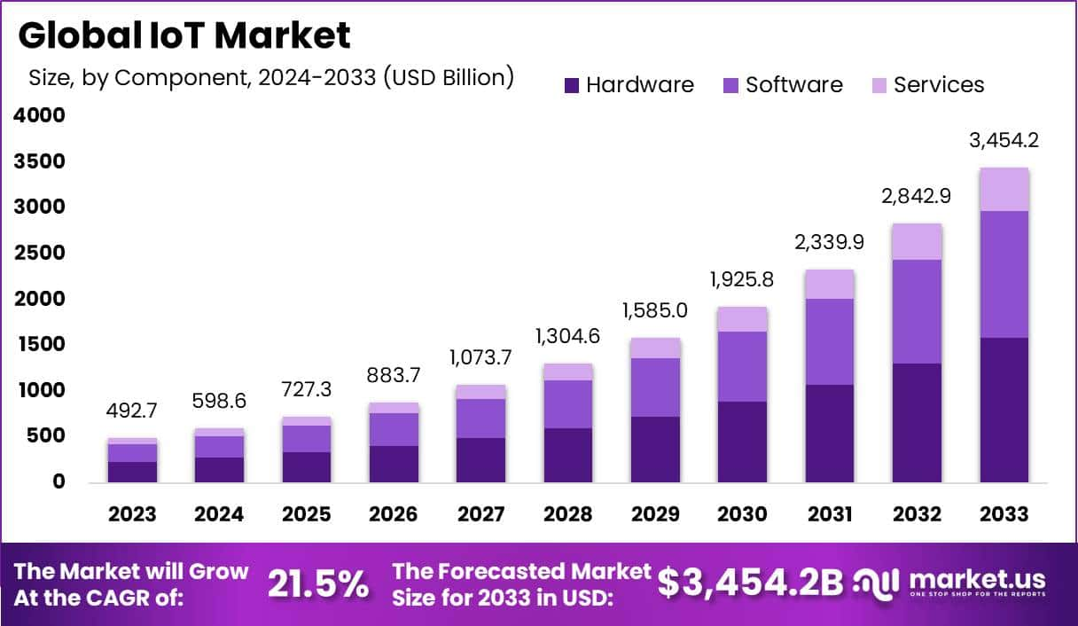
Target Market
.
14

Slide 7
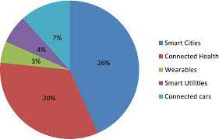
Market Size
The global IoT market is booming—valued at over $500 billion in 2023, it's expected to exceed $3 trillion by 2030, driven by smart homes, smart cities, and industrial automation.

Slide 8

Competitors
Competitors:
PTC(ThingWorx), ARM, Particle
The aim of my project is to focus on local
Problem-Solving, whereby I will be using
IoT and Embedded systems to solve things like load-shedding, Water management, etc
23

Slide 9
Competitive Advantage
What makes you unique?

Slide 10
Project Traction
Tasks
Month 1
Month 2
Month 3
Month 4
Month 5
Problem identification
System Architecture design
Build and test of prototype
Deploying of the prototype and gathering user feedback
Preparation of reports, presentation, and plan for scaling the project
23

Slide 11
Business Model
Hardware Sales – Selling smart devices, sensors, or kits.
Subscription Services – Charging for cloud storage, analytics, or remote access features.
Custom IoT Solutions – Designing and deploying tailored systems for clients (e.g., farms, factories).
Data Monetization – Selling insights or usage data (with user consent).
Maintenance & Support Plans – Charging for system monitoring, updates, and technical support.
23

Slide 12
Go To Market
Partner with local municipalities and utility providers
Attend tech expos, energy summits, and engineering conferences
Launch a website with demos, case studies, and contact forms

Slide 13
Social Impact
SDG 7: Affordable and Clean Energy
SDG 9: Industry, Innovation, and Infrastructure
SDG 11: Sustainable Cities and Communities
SDG 12: Responsible Consumption and Production
SDG 13: Climate Action

Slide 14

Our Ask
I am seeking R300 000 in funding to support the development and deployment of a Smart Energy Management System that will help South African households and businesses mitigate the effects of load-shedding by intelligently switching between grid and solar energy.

Slide 15

Team Members
Sebongile Keswa
Student (Computer systems)
Wamaanda Phaswana
Student (Computer systems)
Elias Metsing
Student (Computer systems)

Slide 16
Thank you!
Contact Number: 063 580 0105
Email address: teboho4000@gmail.com
Linkedin: Teboho Given
17

